Slide 1
Peak level (234V)
SC Begins
Hard Turn-Off
10V

Slide 2
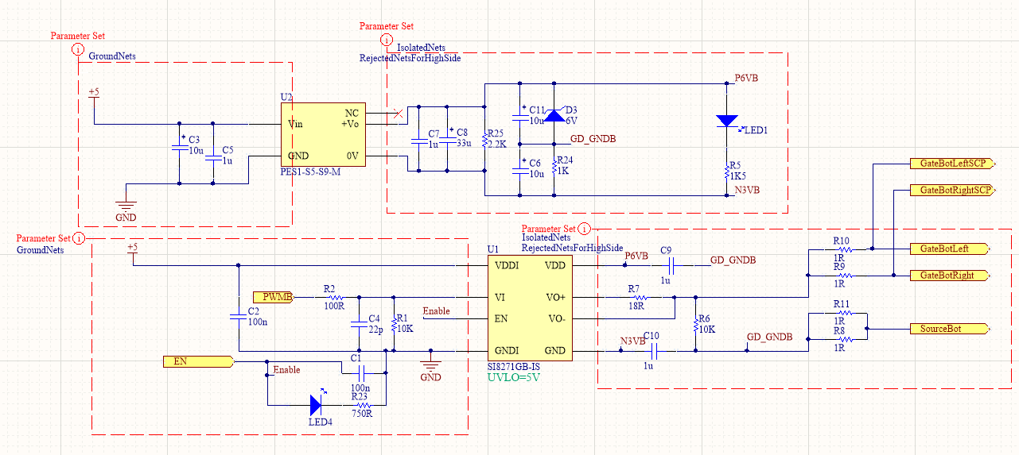
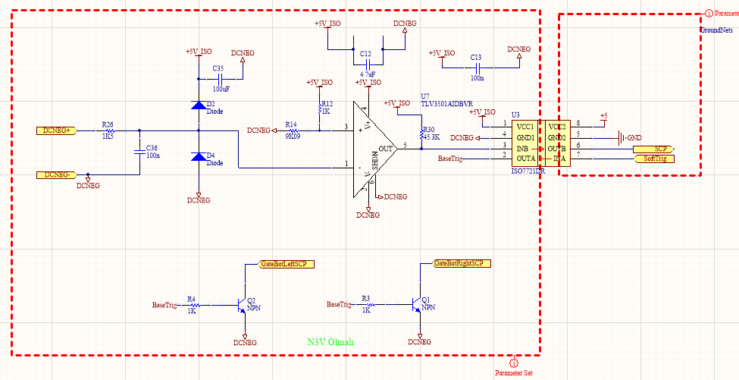

Slide 3
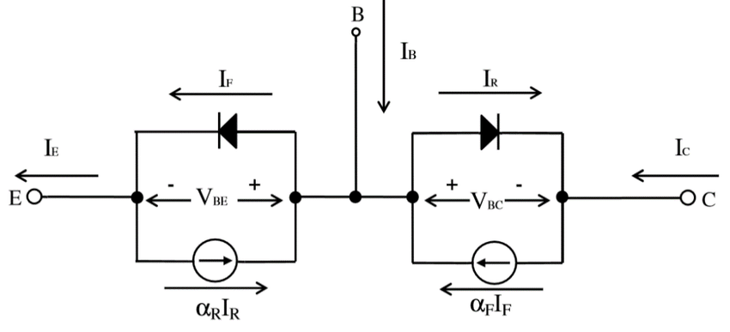
Ebers Moll Model

Slide 4
???
Observation List
BJT Base voltage wrt Emitter voltage
BJT Collector voltage wrt Emitter voltage
BaseTrig voltage wrt Emitter voltage
Isolated supply for comparator
Positive and negative terminal voltages of isolated gate driver supply wrt gnd net

Slide 5
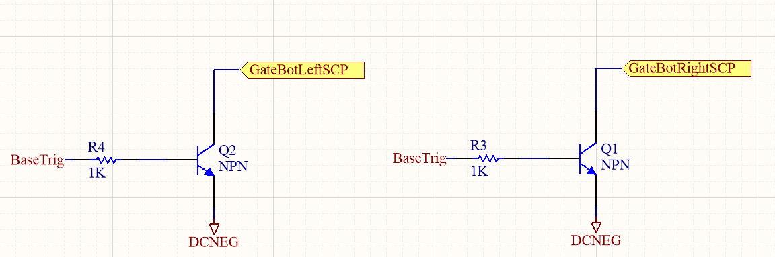
Solution

